Slide 1
Lesson 6 – Personal and professional development
Professionalism for group trainers

Slide 2
Learning objectives
By the end of the lesson you will be able to:
Explain the importance of the planning and reviewing cycle within personal and continuing professional development
Define continuing professional development
Explain the benefits of continuing professional development (CPD) for self, clients and organisations
Explain how to reflect on your work and highlight ways of improving skills, knowledge and practice
Describe how to work with others to evaluate your skills, knowledge and practice
Explain how to plan your continuing professional development
Explain the contribution that a workplace’s performance appraisal and development processes can make to your continuing professional development
Outline the roles and support available from the national governing body and professional associations to support continuing professional development

Slide 3
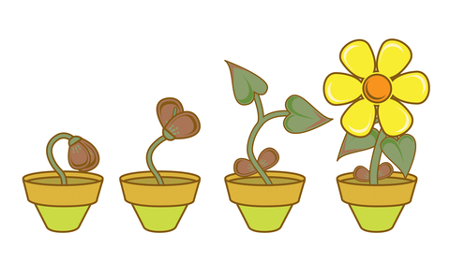
Customer complaints
What does personal development mean?

Slide 4

Personal development is:
An important lifelong process.
A way to:
  Assess your skills and qualities.
  Consider your aims in life.
  Set goals.
  Reflect on your own learning, performance and achievement.
In order to realise and maximise your potential and develop as a 'whole person' in all areas of life.

Slide 5

The benefits of personal development
Personal: Increases your confidence in your own identity, competencies, attributes, aims and aspirations.
Academic: Enables you to focus on what you are learning, how you learn best and how to improve on your achievements.
Social: Builds awareness of the needs of other individuals/groups and the importance of different relationship and team roles.
Professional: Helps you to be more strategic in developing skills for employability.

Slide 6

Professional development and CPD
What does continuing professional development (CPD) mean?

Slide 7


Professional development and CPD
The process of tracking and documenting the skills, knowledge and experience that are gained, both formally and informally, through work, beyond any initial training.
A record of what is experienced, learned and then applied.

Slide 8
Benefits of CPD – to you
Manage your own learning and growth.
Develop your skills and knowledge.
Build confidence and credibility.
Earn more money by showcasing achievements.
Achieve your career goals by focusing on training and development.
Cope positively with change by constantly updating your skills set.
Be more productive and efficient by reflecting on learning and highlighting gaps in knowledge and experience.

Slide 9
Benefits of CPD – to your organisation
CPD helps your organisation by:
Helping to maximise staff potential by linking learning to actions and theory to practice.
Helping employees to set SMART (specific, measurable, achievable, realistic and time-bound) objectives.
Linking training activities to business needs.
Promoting staff development, leading to better staff morale and motivation, and helps give a positive image/brand to other organisations.
Adding value: helps staff to consciously apply learning to their role and the organisation’s development.
Linking to appraisals: CPD is a good tool to help employees identify their achievements throughout the year.
Improving learning and other skills over time.

Slide 10

Self-reflection
For each of the following areas:
Personal.
Educational.
Career development.
Ask yourself:
How well am I doing?
What are my strengths?
What could I do better?
What activities will help me towards my goals?

Slide 11
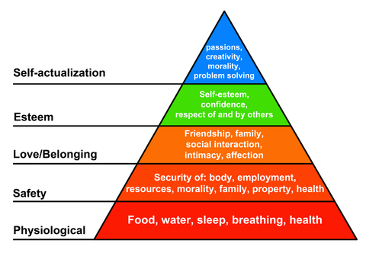
Maslow’s hierarchy of needs

Slide 12
Maslow’s hierarchy of needs
In order to be truly motivated, some progressive needs must be satisfied. Each level needs to be met before moving to the next.
Physiological – the need for sleep and sustenance.
Security and safety – the need for a place to live, a secure environment and freedom from hostility.
Love – the need to be accepted by colleagues, friends and loved ones.
Esteem – the need for self-belief, self-confidence and self-esteem.
Self-actualisation – if all the above are met, the individual will be motivated to achieve ‘self-actualisation’. This is the point at which the person arrives at his/her set goal and where he/she begins to feel fulfilled, successful and truly motivated.

Slide 13

Fixed and growth mindsets
What is a mindset?
What is a fixed mindset?
What is a growth mindset?

Slide 14
What is a mindset?
Our mindset is the attitude we choose to adopt, and it can be changed.
It is to do with what we think we are capable of achieving. Our mindset is about our attitude to life and all its challenges.
People either have a fixed mindset or a growth mindset.
‘Just because some people can do something with little or no training, it doesn’t mean that others can’t do it (and sometimes do it even better) with training.’
Carol Dweck, Mindset: The New Psychology of Success

Slide 15
Growth mindset
People with a growth mindset believe that most things can be achieved through hard work, practice and by not giving up when things get difficult. They know that some people might be particularly talented at certain things but recognise that for them this is just a starting point and that even these people need to work hard in order to improve on their talent.
People who have a growth mindset achieve more in life, whether in sport, music, acting, business or exam results. They achieve more because they have resilience. When things get hard they don’t give up; they hang in there, keep practising and give it another shot until they get it right.

Slide 16
Fixed mindset
People with a fixed mindset believe that their basic skills and qualities are more or less set from birth and there is not a lot they can do about it.
They adopt the attitude of ‘It’s okay for her, she’s brainy’, ‘He’s artistic’, ‘He’s sporty’ or ‘She’s musical’.
If they are not good at something from the word go, then they don’t see the point in putting in the effort to learn it.

Slide 17

Transferable skills
What are transferable skills?
List as many examples as you can think of.

Slide 18
Transferable skills
Transferable skills are:
Skills and abilities that are relevant and helpful across different areas of life, for example, socially, professionally and at school/college/university.
Transferable skills include:
Personal motivation.
Organisation.
Time-management.
Teamwork.
Leadership skills.

Slide 19

Hard and soft skills
What are hard and soft skills?
List as many examples as you can think of.

Slide 20
Hard skills
Hard skills are quantifiable, often technical and learned at school/college/university, or by doing particular work over a period of time.
Knowing a particular hard skill makes you in demand. Hard skills may be the difference between getting or not getting a particular job over other candidates.
For example:
Fluency in a foreign language may enable you to apply and secure a role requiring international travel for work.
Skill or knowledge of particular software will enable you to seek a role specifically working on that software package.

Slide 21
Soft skills
Soft skills (also known as employability skills) are the skills and attitudes that enable you to get along with colleagues, to make critical decisions, solve problems, develop respect and ultimately become strong ambassadors for an organisation.
For example – good interpersonal and communication skills will enable you to:
  Participate effectively as a member of a team.
  Satisfy customer expectations.
  Negotiate.
  Make decisions.
  Manage your time efficiently.
  Take responsibility.
  Work effectively with other employees…

Slide 22
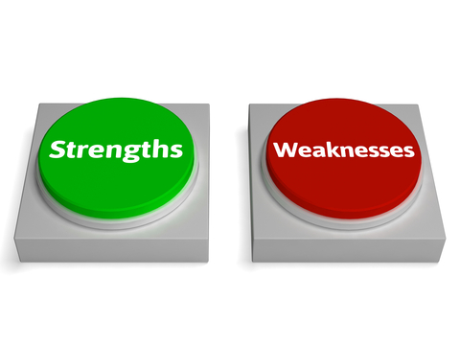
Individual strengths and weaknesses
Why is it important to highlight your strengths?
Why is it important to highlight your weaknesses?

Slide 23
Strengths and weaknesses
Exploring strengths will give an indication of the following:
What skills and experience do you already possess?
What are you able to do well already?
What do others see as your strengths?
Exploring weaknesses will give an indication of the following:
What areas of development could you improve on?
Is there a lack of experience that may be needed for a long-term career?
What areas are done badly?
What should be avoided?
Do friends or family think there are weaknesses that you do not agree with?

Slide 24
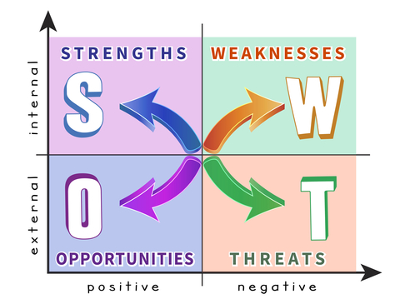
SWOT analysis

Slide 25
Planning and reviewing cycle
Identify areas to develop.
Plan development needs.
Action development.
Reflect and review outcomes of development.

Slide 26


Planning and reviewing cycles
Why are planning and reviewing cycles important within personal and professional development?

Slide 27

Planning and reviewing cycles – benefits
They provide the opportunity for self-reflection.
Ensure SMART goals are put in place to ensure development is measurable.
Encourage significant others to support, for example, managers.
Ensure you keep up to date with industry standards and new opportunities.

Slide 28
Learning review
Can you now:
Explain the importance of the planning and reviewing cycle within personal and continuing professional development?
Define continuing professional development?
Explain the benefits of continuing professional development (CPD) for self, clients and organisations?
Explain how to reflect on your work and highlight ways of improving skills, knowledge and practice?
Describe how to work with others to evaluate your skills, knowledge and practice?
Explain how to plan your continuing professional development?
Explain the contribution that a workplace’s performance appraisal and development processes can make to your continuing professional development?
Outline the roles and support available from the national governing body and professional associations to support continuing professional development?

